Slide 1
Data Preparation
Dr. Alaa Sheta

Slide 2
Data Preparation
Regular Expressions

Slide 3
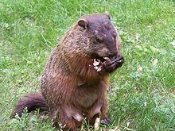
Regular expressions
A formal language for specifying text strings
How can we search for any of these?
woodchuck
woodchucks
Woodchuck
Woodchucks

Slide 4
Regular Expressions: Disjunctions
Letters inside square brackets []
Pattern | Matches
[wW]oodchuck | Woodchuck, woodchuck
[1234567890] | Any digit
Ranges [A-Z]
Pattern | Matches
[A-Z] | An upper case letter | Drenched Blossoms
[a-z] | A lower case letter | my beans were impatient
[0-9] | A single digitChapte | r 1: Down the Rabbit Hole

Slide 5
Regular Expressions: Negation in Disjunction
Negations [^Ss]
Carat means negation only when first in []
Pattern | Matches
[^A-Z] | Not an upper case letterO | yfn pripetchik
[^Ss] | Neither ‘S’ nor ‘s’ | I have no exquisite reason”
[^e^] | Neither e nor ^Look h | ere
a^b | The pattern a carat bLoo | k up a^b now

Slide 6
Regular Expressions: More Disjunction
Woodchucks is another name for groundhog!
The pipe | for disjunction
Pattern | Matches
groundhog|woodchuck
yours|mine | yours mine
a|b|c | = [abc]
[gG]roundhog|[Ww]oodchuck

Slide 7
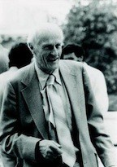
Regular Expressions: ? * + .
Pattern | Matches
colou?r | Optional previous char | color colour
oo*h! | 0 or more of previous char | oh! ooh! oooh! ooooh!
o+h! | 1 or more of previous char | oh! ooh! oooh! ooooh!
baa+ |  | baa baaa baaaa baaaaa
beg.n |  | begin begun begun beg3n
Stephen C Kleene
Kleene *, Kleene +

Slide 8
Regular Expressions: Anchors ^ $
Pattern | Matches
^[A-Z] | Palo Alto
^[^A-Za-z] | 1 “Hello”
\.$ | The end.
.$ | The end? The end!

Slide 9
Example
Find me all instances of the word “the” in a text.
the
Misses capitalized examples
[tT]he
Incorrectly returns otheror theology [^a-zA-Z][tT]he[^a-zA-Z]

Slide 10
Errors
The process we just went through was based onfixing two kinds of errors
Matching strings that we should not have matched ( there, then, other)
False positives (Type I)
Not matching things that we should have matched (The)
False negatives (Type II)

Slide 11
Errors cont.
In NLP we are always dealing with these kinds of errors.
Reducing the error rate for an application often involves two antagonistic efforts:
Increasing accuracy or precision (minimizing false positives)
Increasing coverage or recall (minimizing false negatives).

Slide 12
Summary
Regular expressions play a surprisingly large role
Sophisticated sequences of regular expressions are often the first model for any text processing text
For many hard tasks, we use machine learning classifiers
But regular expressions are used as features in the classifiers
Can be very useful in capturing generalizations
11

Slide 13
Data Preparation
Word tokenization

Slide 14
Text Normalization
Every NLP task needs to do text normalization:
Segmenting/tokenizing words in running text
Normalizing word formats
Segmenting sentences in running text

Slide 15
How many words?
I do uh main-­‐mainly business data processing
Fragments, filled pauses
Seuss’s cat in the hat is different from other cats!
Lemma: same stem, part of speech, rough word sense
cat and cats = same lemma
Wordform: the full inflected surface form
cat and cats = different wordforms

Slide 16
How many words?
they lay back on the San Francisco grass and looked at the stars and their
Type: an element of the vocabulary.
Token: an instance of that type in running text.
How many?
15 tokens (or 14)
13 types (or 12) (or 11?)

Slide 17
How many words?
N= number of tokens
V= vocabulary = set of types
|V| is the size of the vocabulary
Church and Gale (1990): |V| > O(N^{½})
 | Tokens = N | Types = |V|
Switchboard phone conversations | 2.4 million | 20 thousand
Shakespeare | 884,000 | 31 thousand
Google N-­‐grams | 1 trillion | 13 million

Slide 18
Simple Tokenization in UNIX
(Inspired by Ken Church’s UNIX for Poets.)
Given a text file, output the word tokens and their frequencies
tr -sc ’A-Za-z’ ’\n’ < shakes.txt
Change all non-alpha to newlines
| sort
| uniq –c
Sort in alphabetical order
Merge and count each type
1945 A
72 AARON
19 ABBESS
5 ABBOT
... ...
25 Aaron
6 Abate
1 Abates
Abbess
Abbey
3 Abbot
.... …

Slide 19
The first step: tokenizing
tr -sc ’A-Za-z’
THE SONNETS
by William
Shakespeare From fairest creatures We
...
’\n’ < shakes.txt | head

Slide 20
The second step: sorting
tr -sc ’A-Za-z’ ’\n’ < shakes.txt
| sort | head
A A A A A A A A A
...

Slide 21
More counting
• | Merging upper and lower case
tr | ‘A-Z’ ‘a-z’ < shakes.txt | tr –sc ‘A-Za-z’ |  |  |  |  |  | ‘\n’ | sort | uniq | –c
• | Sorting the counts
tr | ‘A-Z’ | ‘a-z’ < shakes.txt | | | tr | –sc | ‘A-Za-z’ ‘\n’ | | sort | uniq –c | sort | –n | –r
23243 | the
22225 | i
18618 | and
16339 | to
15687 | of
12780 | a
12163 | you
10839 | my
10005 | in
8954 | d
What happened here?

Slide 22
Issues in Tokenization
Finland’s capital →Finland Finlands
what’re, I’m, isn’t→What are, I am,
Hewlett-Packard →Hewlett Packard ?
state-of-the-art →state of the
Lowercase→lower-case lowercase lower case ?
San Francisco→
m.p.h., PhD.→??
Finland’s ?
is not
art ?
one token or two?

Slide 23
Tokenization: language issues
French
L'ensemble→one token or two?
L ? L’ ? Le ?
Want l’ensembleto match with un ensemble
German noun compounds are not segmented
Lebensversicherungsgesellschaftsangestellter
‘life insurance company employee’
German information retrieval needs compound splitter

Slide 24
Word Tokenization in Chinese
Also called Word Segmentation
Chinese words are composed of characters
Characters are generally 1 syllable and 1 morpheme.
Average word is 2.4 characters long.
Standard baseline segmentation algorithm:
Maximum Matching (also called Greedy)

Slide 25
Maximum Matching
Word Segmentation Algorithm
Given a wordlist of Chinese, and a string.
Start a pointer at the beginning of the string
Find the longest word in dictionary that matches the string starting at pointer
Move the pointer over the word in string
Go to 2

Slide 26
Max-­‐match segmentation illustration
Thecatinthehat
Thetabledownthere
the cat in the hat the table down there theta bled own there
Doesn’t generally work in English!
But works astonishingly well in Chinese
Modern probabilistic segmentation algorithms even better

Slide 27
Data Preparation
Word Normalization and Stemming

Slide 28
Normalization
Need to “normalize” terms
Information Retrieval: indexed text & query terms must have same form.
We want to match U.S.A.and USA
We implicitly define equivalence classes of terms
e.g., deleting periods in a term
Alternative: asymmetric expansion:
Enter: windowSearch: window, windows
Enter: windowsSearch: Windows, windows, window
Enter: WindowsSearch: Windows
Potentially more powerful, but less efficient

Slide 29
Case folding
Applications like IR: reduce all letters to lower case
Since users tend to use lower case
Possible exception: upper case in mid-­‐sentence?
e.g., General Motors
Fedvs. fed
SAILvs. sail
For sentiment analysis, MT, Information extraction
Case is helpful (USversus us is important)

Slide 30
Lemmatization
Reduce inflections or variant forms to base form
am, are, is →be
car, cars, car's, cars'→car
the boy's cars are different colors→the boy car be different color
Lemmatization: have to find correct dictionary headword form
Machine translation
Spanish quiero (‘I want’), quieres (‘you want’) same lemma as querer ‘want’

Slide 31
Morphology
Morphemes:
The small meaningful units that make up words
Stems: The core meaning-­‐bearing units
Affixes: Bits and pieces that adhere to stems
Often with grammatical functions

Slide 32
Stemming
Reduce terms to their stems in information retrieval
Stemmingis crude chopping of affixes
language dependent
e.g., automate(s), automatic, automationall reduced to automat.
for example compressed and compression are both accepted as equivalent to compress.
for exampl compress and compress ar both accept as equival to compress

Slide 33
Porter’s algorithm
The most common English stemmer
Step 1a
sses→ss ies→i ss→ss
s →ø
Step 1b
Step 2 (for long stems)
caresses →caress
ational→ate izer→ize ator→ate
…
relational→relate digitizer →digitize operator →operate
ponies caress cats
→poni
→caress
→cat
Step 3 (for longer stems)
(*v*)ing→ø
walking sing
→walk
→sing
al →ø
revival adjustable activate
→reviv
→adjust
→activ
able →ø
ate →ø
…
(*v*)ed→ø
…
plastered →plaster

Slide 34
Viewing morphology in a corpus
Why only strip –ing if there is a vowel?
(*v*)ing→ø
walking sing
→walk
→sing
36

Slide 35
Viewing morphology in a corpus
Why only strip –ing if there is a vowel?
(*v*)ing→ø
walking sing
→walk
→sing
tr | -sc | 'A-Za-z' | '\n' | < shakes.txt | | | grep | ’ing$' | sort | | | uniq | -c | | sort | –nr
 |  |  | 1312 | King |  | 548 | being
 |  |  | 548 | being |  | 541 | nothing
 |  |  | 541 | nothing |  | 152 | something
 |  |  | 388 | king |  | 145 | coming
 |  |  | 375 | bring |  | 130 | morning
 |  |  | 358 | thing |  | 122 | having
 |  |  | 307 | ring |  | 120 | living
 |  |  | 152 | something |  | 117 | loving
 |  |  | 145 | coming |  | 116 | Being
 |  |  | 130 | morning |  | 102 | going
tr | -sc | 'A-Za-z' | '\n' < shakes.txt |  | | grep '[aeiou].*ing$' |  |  | | | sort | | uniq -c |  | | sort | –nr
 | 37

Slide 36
Dealing with complex morphology is sometimes necessary
Some languages requires complex morpheme segmentation
Turkish
Uygarlastiramadiklarimizdanmissinizcasina
`(behaving) as if you are among those whom we could not civilize’
Uygar `civilized’ + las `become’
+ tir `cause’ + ama `not able’
+ dik `past’ + lar ‘plural’
+ imiz ‘p1pl’ + dan ‘abl’
+ mis ‘past’ + siniz ‘2pl’ + casina ‘as if’

Slide 37
Data Preparation
Sentence Segmentation and Decision Trees

Slide 38
Sentence Segmentation
!, ? are relatively unambiguous
Period “.” is quite ambiguous
Sentence boundary
Abbreviations like Inc. or Dr.
Numbers like .02% or 4.3
Build a binary classifier
Looks at a “.”
Decides EndOfSentence/NotEndOfSentence
Classifiers: hand-­‐written rules, regular expressions, or machine-­‐learning

Slide 39
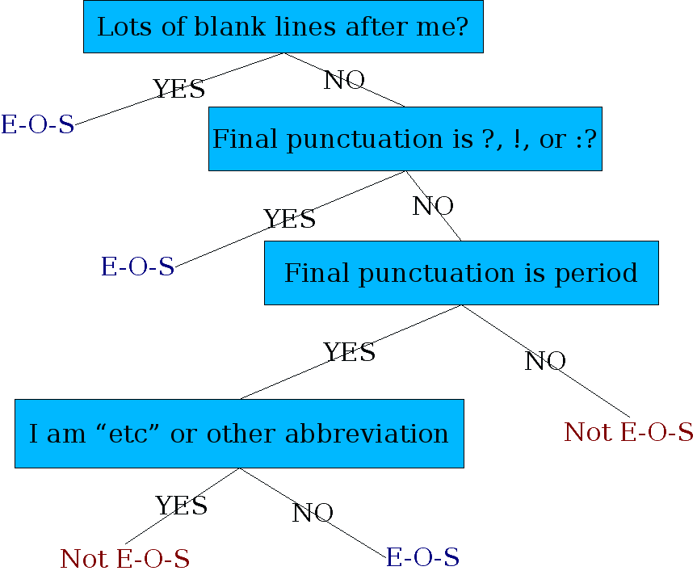
Determining if a word is end-­‐of-­‐sentence: a Decision Tree

Slide 40
More sophisticated decision tree features
Case of word with “.”: Upper, Lower, Cap, Number
Case of word after “.”: Upper, Lower, Cap, Number
Numeric features
Length of word with “.”
Probability(word with “.” occurs at end-­‐of-­‐s)
Probability(word after “.” occurs at beginning-­‐of-­‐s)

Slide 41
Implementing Decision Trees
A decision tree is just an if-­‐then-­‐else statement
The interesting research is choosing the features
Setting up the structure is often too hard to do by hand
Hand-­‐building only possible for very simple features, domains
For numeric features, it’s too hard to pick each threshold
Instead, structure usually learned by machine learning from a training corpus

Slide 42
Decision Trees and other classifiers
We can think of the questions in a decision tree
As features that could be exploited by any kind of classifier
Logistic regression
SVM
Neural Nets
etc.

Slide 43
Data Preparation
Words and Corpora

Slide 44
How many words?
"I do uh main- mainly business data processing"
Fragments, filled pauses
"Seuss’s cat in the hat is different from other cats!"
Lemma: same stem, part of speech, rough word sense
cat and cats = same lemma
Wordform: the full inflected surface form
cat and cats = different wordforms

Slide 45
How many words?
they lay back on the San Francisco grass and looked at the stars and their
Type: an element of the vocabulary.
Token: an instance of that type in running text.
How many?
15 tokens (or 14)
13 types (or 12) (or 11?)

Slide 46
How many words?
N = number of tokens
V = vocabulary = set of types, |V| is size of vocabulary
Heaps Law = Herdan's Law = where often .67 < β < .75
i.e., vocabulary size grows with > square root of the number of word tokens
 | Tokens = N | Types = |V|
Switchboard phone conversations | 2.4 million | 20 thousand
Shakespeare | 884,000 | 31 thousand
COCA | 440 million | 2 million
Google N-grams | 1 trillion | 13+ million

Slide 47
Corpora
Words don't appear out of nowhere.
A text is produced by a specific writer(s), at a specific time, in a specific variety of a specific language, for a specific function.

Slide 48
Corpora vary along dimension like
Language: 7097 languages in the world
Variety, like African American Language varieties.
AAL Twitter posts might include forms like "iont" (I don't)
Code switching, e.g., Spanish/English, Hindi/English:
S/E: Por primera vez veo a @username actually being hateful! It was beautiful:)
[For the first time I get to see @username actually being hateful! it was beautiful:) ]
H/E: dost tha or ra- hega ... dont wory ... but dherya rakhe
[“he was and will remain a friend ... don’t worry ... but have faith”]
Genre: newswire, fiction, non-fiction, scientific articles, Wikipedia
Author Demographics: writer's age, gender, race, socioeconomic status, etc.

Slide 49
Corpus datasheets
Gebru et al (2020), Bender and Friedman (2018)
Motivation: Why was the corpus collected, by whom, and who funded it?
Situation: In what situation was the text written?
Collection process: If it is a subsample how was it sampled? Was there consent? Pre-processing?
+Annotation process, Language variety, speaker demographics

Slide 50
Data Preparation
Byte Pair Encoding tokenization

Slide 51
A third option for word segmentation
Use the data to tell us how to tokenize.
Subword tokenization (because tokens are often parts of words)
Can include common morphemes like -est or -er.
(A morpheme is the smallest meaning-bearing unit of a language; unlikeliest has morphemes un-, likely, and -est.)

Slide 52
Subword tokenization
Three common algorithms:
Byte-Pair Encoding (BPE) (Sennrich et al., 2016)
unigram language modeling tokenization (Kudo, 2018)
WordPiece (Schuster and Nakajima, 2012)
All have 2 parts:
A token learner that takes a raw training corpus and induces a vocabulary (a set of tokens).
A token segmenter that takes a raw test sentence and tokenizes it according to that vocabulary

Slide 53
Byte Pair Encoding (BPE)
Let vocabulary be the set of all individual characters
= {A, B, C, D,…,a, b, c, d….}
Repeat:
choose the two symbols that are most frequently adjacent in training corpus (say ‘A’, ‘B’),
adds a new merged symbol ‘AB’ to the vocabulary
replace every adjacent ’A’ ’B’ in corpus with ‘AB’.
Until k merges have been done.

Slide 54
BPE token learner algorithm

Slide 55
Byte Pair Encoding (BPE)
Most subword algorithms are run inside white-space separated tokens.
So first add a special end-of-word symbol '__' before whitespace in training corpus
Next, separate into letters.

Slide 56
BPE token learner
Original (very fascinating🙄) corpus:
low low low low low lowest lowest newer newer newer newer newer newer wider wider wider new new
Add end-of-word tokens and segment:

Slide 57
BPE token learner
Merge e r to er

Slide 58
BPE
Merge er _ to er_

Slide 59
BPE
Merge n e to ne

Slide 60
BPE
The next merges are:

Slide 61
BPE token learner algorithm
On the test data, run each merge learned from the training data:
Greedily
In the order we learned them
(test frequencies don't play a role)
So: merge every e r to er, then merge er _ to er_, etc.
Result:
Test set "n e w e r _" would be tokenized as a full word
Test set "l o w e r _" would be two tokens: "low er_"

Slide 62
Data Preparation
Word Normalization and other issues

Slide 63
Word Normalization
Putting words/tokens in a standard format
U.S.A. or USA
uhhuh or uh-huh
Fed or fed
am, is be, are

Slide 64
Case folding
Applications like IR: reduce all letters to lower case
Since users tend to use lower case
Possible exception: upper case in mid-sentence?
e.g., General Motors
Fed vs. fed
SAIL vs. sail
For sentiment analysis, MT, Information extraction
Case is helpful (US versus us is important)

Slide 65
Lemmatization
Represent all words as their shared root, = dictionary headword form:
am, are, is → be
car, cars, car's, cars' → car
Spanish quiero (‘I want’), quieres (‘you want’) → querer ‘want'
He is reading detective stories → He be read detective story

Slide 66
Lemmatization is done by Morphological Parsing
Morphemes:
The small meaningful units that make up words
Stems: The core meaning-bearing units
Affixes: Parts that adhere to stems, often with grammatical functions
Morphological Parsers:
Parse cats into two morphemes cat and s
Parse Spanish amaren (‘if in the future they would love’) into morpheme amar ‘to love’, and the morphological features 3PL and future subjunctive.

Slide 67
Stemming
Reduce terms to stems, chopping off affixes crudely
Thi wa not the map we found in Billi Bone s chest but an accur copi complet in all thing name and height and sound with the singl except of the red cross and the written note
.
This was not the map we found in Billy Bones’s chest, but an accurate copy, complete in all things-names and heights and soundings-with the single exception of the red crosses and the written notes.

Slide 68
Porter Stemmer
Based on a series of rewrite rules run in series
A cascade, in which output of each pass fed to next pass
Some sample rules:

Slide 69
Dealing with complex morphology is necessary for many languages
E.g., the Turkish word:
Uygarlastiramadiklarimizdanmissinizcasina
`(behaving) as if you are among those whom we could not civilize’
Uygar `civilized’ + las `become’
+ tir `cause’ + ama `not able’
+ dik `past’ + lar ‘plural’
+ imiz ‘p1pl’ + dan ‘abl’
+ mis ‘past’ + siniz ‘2pl’ + casina ‘as if’

Slide 70
Sentence Segmentation
!, ? are relatively unambiguous but period “.” is quite ambiguous
Sentence boundary
Abbreviations like Inc. or Dr.
Numbers like .02% or 4.3
Common Algorithm: decide (using rules or ML) whether a period is part of the word or is a sentence-boundary marker.
An abbreviation dictionary can help
Sentence segmentation can then often be done by rules based on this tokenization.

